Slide 1
Long-Acting Injectables for PrEP
Sinead Delany-Moretlwe
University of the Witwatersrand
IAS, Amsterdam, July 2018

Slide 2
New HIV prevention options are needed for women
Women account for more than half of adults living with HIV globally
Young women are twice as likely to be living with HIV as young men
Women currently have few HIV prevention options that are directly under their control
PrEP offers new promise for HIV prevention

Slide 3



Women require high levels of adherence to oral PrEP to ensure protection
7 Pills Per Week
94%
99%
Best Protection Best Protection
Hanscom, JAIDS 2016; Fonner, AIDS 2016
Notes:
Data for the next three slides comes from
Hanscom, B., Janes, H. E., Guarino, P. D., Huang, Y., Brown, E. R., Chen, Y. Q., … Donnell, D. J. (2016). Preventing HIV-1 Infection in Women using Oral Pre-Exposure Prophylaxis: A Meta-analysis of Current Evidence. Journal of Acquired Immune Deficiency Syndromes (1999), 73(5), 606–608. http://doi.org/10.1097/QAI.0000000000001160
Fonner, V. A., Dalglish, S. L., Kennedy, C. E., Baggaley, R., O’Reilly, K. R., Koechlin, F. M., … Grant, R. M. (2016). Effectiveness and safety of oral HIV preexposure prophylaxis for all populations. AIDS (London, England), 30(12), 1973–1983. http://doi.org/10.1097/QAD.0000000000001145
Adherence refers to how well an individual follows guidelines. How well PrEP works depends on how regularly participants used PrEP, with greater protection for those who took the pills as prescribed. Low adherence reduces the effectiveness of PrEP. ADDED We are able to measure drug levels in the blood. In the trials we saw that those with detectable drug in their blood (not all did) had high levels of protection from HIV.

Slide 4
Women require high levels of adherence to oral PrEP to ensure protection
4 Pills Per Week
61%
6%
90%
76%
Good Protection Better Protection
Hanscom, JAIDS 2016; Fonner, AIDS 2016
Notes:
Men can miss a dose of oral Truvada and still be protected from getting HIV by 90%. However, women need to take oral Truvada daily to maintain protection above 90%.

Slide 5
Women require high levels of adherence to oral PrEP to ensure protection
2 Pills Per Week
6%
76%
Poor Protection Good Protection
Hanscom, JAIDS 2016; Fonner, AIDS 2016
Notes:
Delivery systems for long acting PrEP options such as injectables could be key in addressing PrEP adherence issues for women who do not like to take pills.

Slide 6
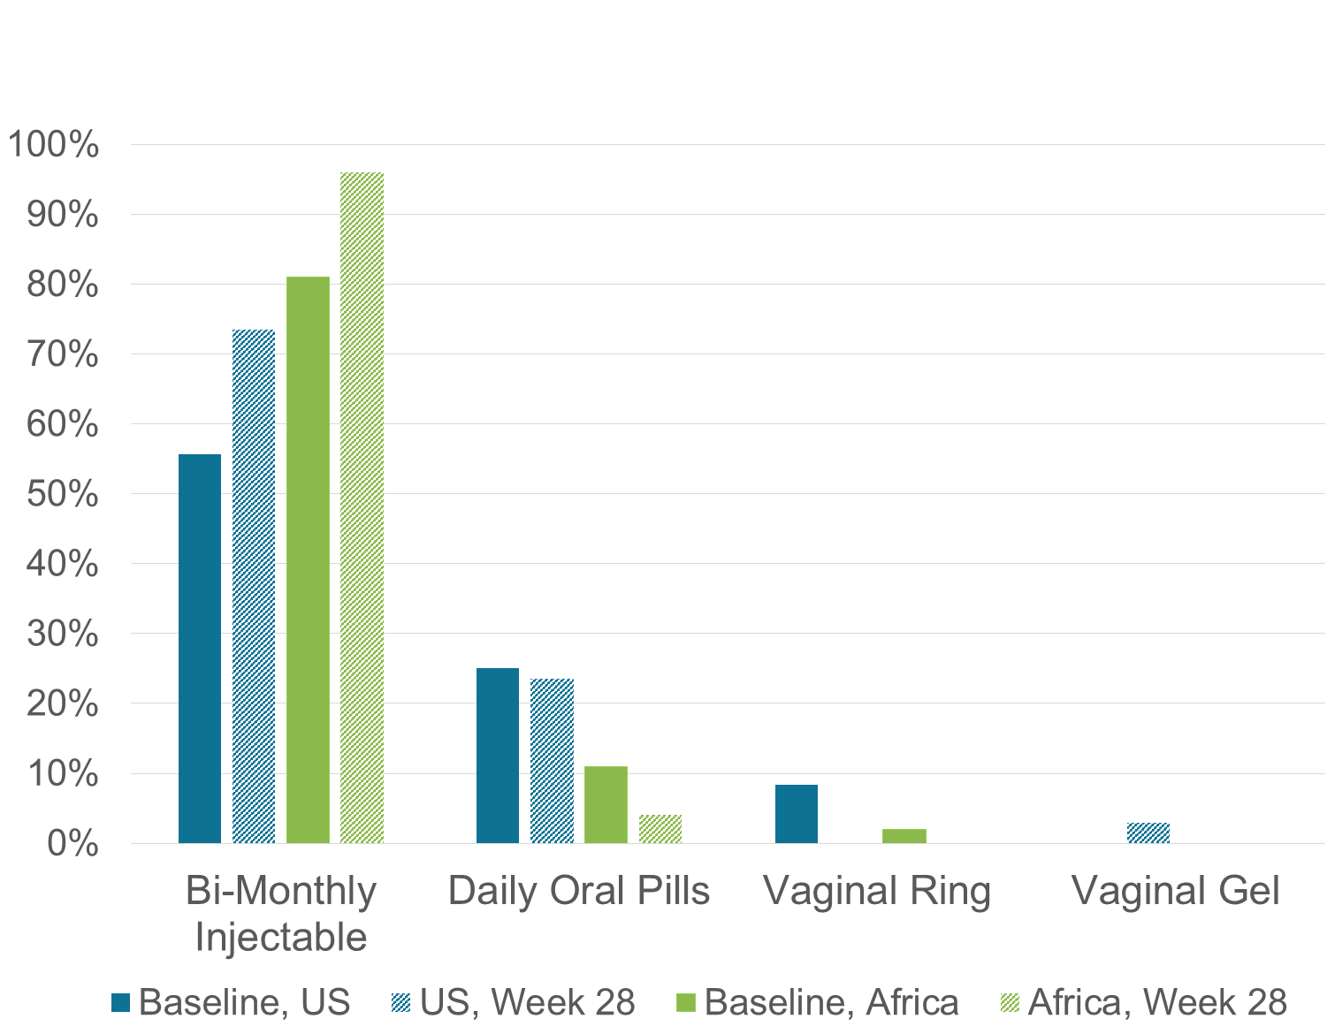
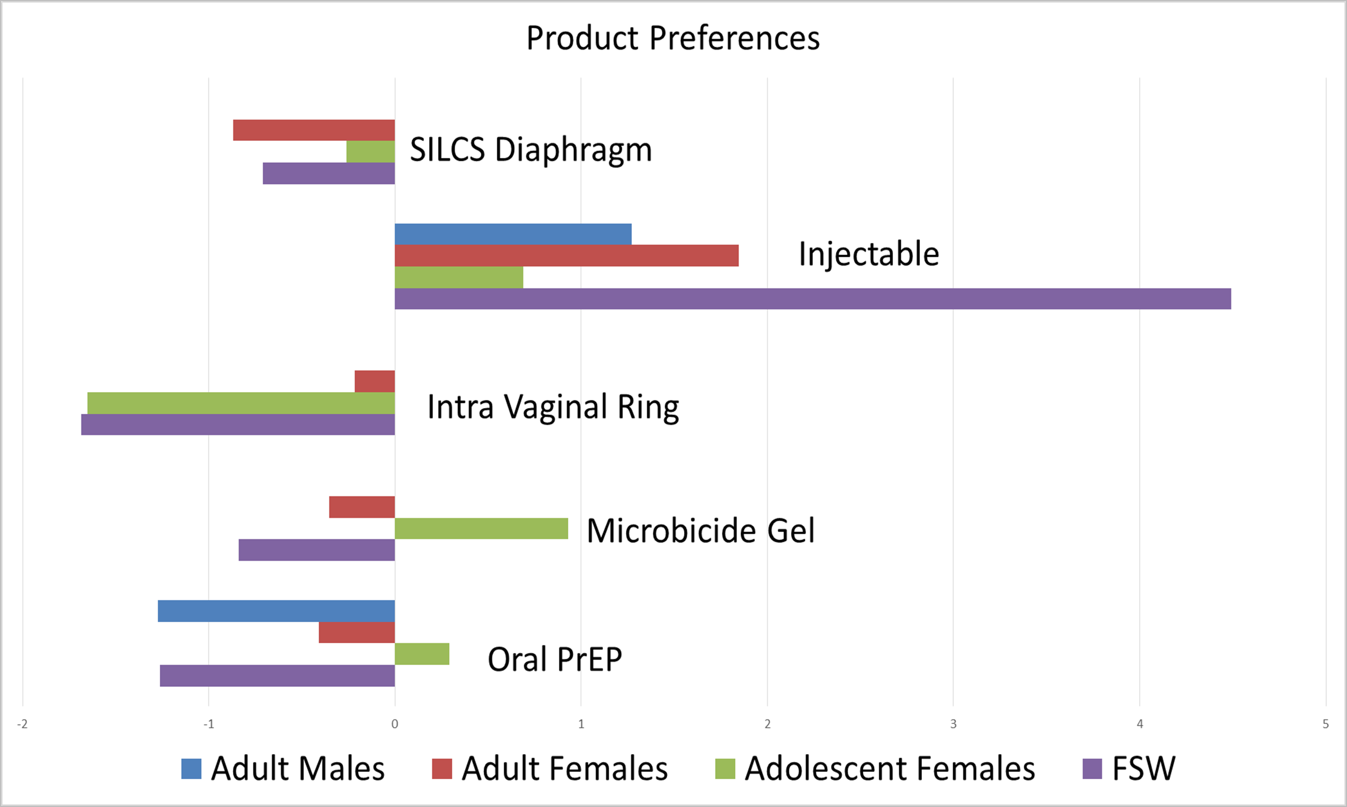
Women’s preferences for long-acting PrEP
Discrete-choice experiment,
South Africa N=535
HPTN 076 Prevention Preferences, Baseline and 28 Weeks (n=136)
Source: Quaife, MDM 2017; Tolley, IAS 2017

Slide 7
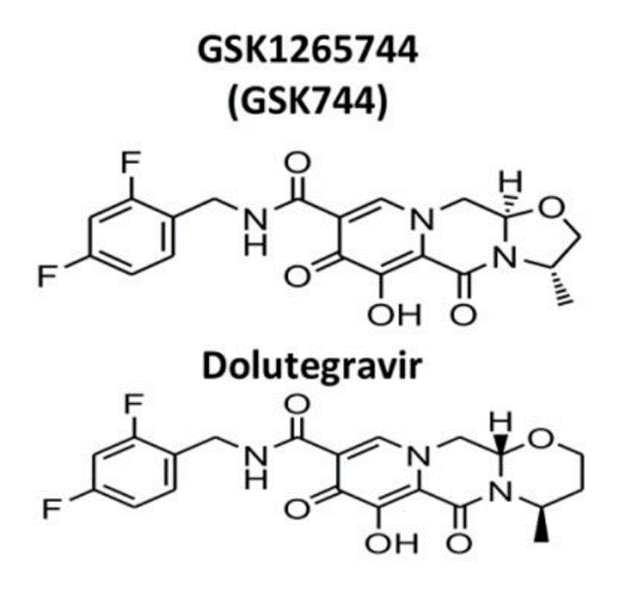
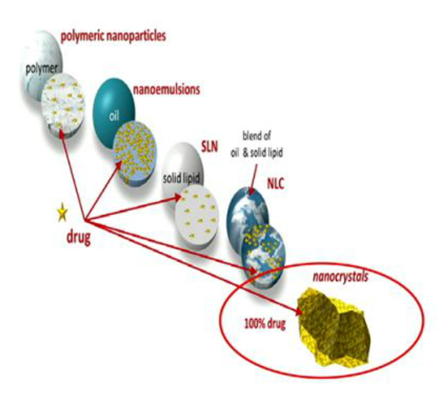
Cabotegravir
Experimental
GSK1265744 = Cabotegravir
Integrase inhibitor
High genetic barrier to resistance
PK profile –allows 1-3 month injectable dosing using nanosuspension formulation
Notes:
Cabotegravir is one such candidate agent.
An integrase inhibitor, it is an analogue of dolutegravir an agent currently licensed for use in treatment
Cabotegravir is favourable as a PrEP agent because has a high genetic barrier to resistance and a long half-life; its phyisco-chemical attributes allowed it to be nano-milled and developed as a nanosuspension for depot injection.
The long half life makes it suitable for injection every 1-3 months
An oral formulation has also been developed for once daily dosing, as an oral lead in therapy to establish safety and tolerability in individuals prior to injection.

Slide 8
CAB LA is effective PrEP vs. vaginal challenge in Rhesus and Pigtail macaques
Drug+virus challenges
Washout
Drug + virus challenges
Washout
CAB LA
CAB LA
CAB LA
CAB LA
CAB LA (last dose)
100
6/8
75
GSK744 (n=6)
Placebo
controls (n=6)
Aviremic (%)
50
25
p = 0.0005
0/4
0
0
2
4
6
8
10
12
14
16
30
Weeks
SHIV 162p3 300xTCID50 Intravaginal Challenge in Female Rhesus Macaques, with DMPA
(viral challenge Week 1, 5 and 7)
SHIV 162p3 50xTCID50 Intravaginal Challenge in Female Pigtail Macaques, no DMPA
(biweekly viral challenges x 22)
Andrews, Science Trans Med 2015
Radzio, Science Trans Med 2015
Notes:
CAB injections prevented vaginal SHIV infection in two non-human primate models.
In one study DMPA pre-treated female rhesus macques (8 active and 4 controls), 6 of 8 female rhesus macaques who received cabotegravir injections at week 0 and week 4 comparable with an 800 mg dose in humans were protected against three high-dose SHIV challenges, whereas all control animals became infected after the first challenge (P = 0.0003, log-rank test).
In a second study in with pigtail macaques -which have a menstrual cycle similar to humans and do not require pre-treatment with DMPA – 12 female pigtail macaques (n = 12) were exposed to intravaginal inoculations of SHIV twice a week for up to 11 weeks.
Half of the animals received a cab LA injection every 4 weeks, and half received placebo.
All six macaques injected with CAB were protected from infection,
while controls were all infected after a median of 4 (range, 2 to 20) vaginal challenges with SHIV.

Slide 9
Cabotegravir Development
Indication
Treatment
Prevention MSM/TGW
Phase 2
LATTE 1
LATTE 2
ÉCLAIR
Phase 3
ATLAS
FLAIR
HPTN 083
Prevention Cis Women
HPTN 077*
HPTN 084
Early Phase
NHP Models
First in Human
Phase 1
Cardiac Safety, DDI
*Includes both men and women

Slide 10
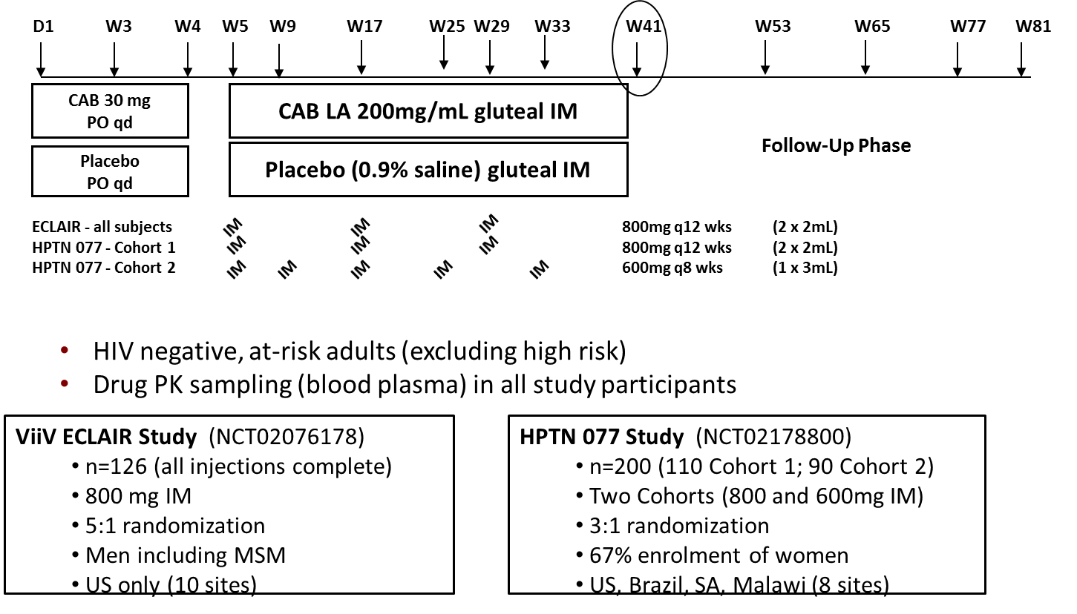
CAB LA PrEP Phase 2 Safety and PK Studies
Notes:
Two phase two studiesInvestigated safety, tolerability and PK
ÉCLAIR
Enrolled men from domestic sites from the US, including MSM
HPTN 077 study
A study with a similar design
oral cabotegravir 30 mg tablets or matching placebo tablets once daily during a 4 week oral lead-in phase, followed by a 1 week washout period
long-acting cabotegravir or saline placebo injections
800 mg or saline placebo at 12 week intervals at weeks 5, 17, and 29

Slide 11

HPTN 077: Grade 2 or Higher AE’s Experienced by >5% of Any Arm During Injection Phase
n=177 (CAB 134, PBO 43)
>
p < 0.0001
p = 0.03
* Grade 2: < 90 to 60 ml/min or 10 to < 30% decrease from participant’s baseline.
Grade 3: < 60 to 30 ml/min or 30 to < 50% decrease from participant’s baseline.
Landovitz, IAS 2017
Notes:
No statistically significant differences between men and women

Slide 12




Cohort 2 Participants Consistently Met Pharmacokinetic Targets
Cohort 1
Cohort 2
Two 2mL (2x400mg)
IM Injections
every 12 Weeks
One 3mL (600mg)
IM Injection
every 8 Weeks
Median Steady
State Trough:
0.72 ug/mL | 1.34 ug/mL
Inj 1: 92% Inj 2: 100% Inj 3: 100% | Inj 1: 100% Inj 2: 100% Inj 3: 100%
Inj 1: 23% Inj 2: 65% Inj 3: 68% | Inj 1: 23% Inj 2: 95% Inj 3: 100%
1.51 ug/mL |  | 2.11 ug/mL
Inj 1: 100% Inj 2: 100% Inj 3: 100% | Inj 4: 100% Inj 5: 100% | Inj 1: 100% Inj 2: 100% Inj 3: 100% | Inj 4: 100% Inj 5: 100%
Inj 1: 95% Inj 2: 80% Inj 3: 80% | Inj 4: 84% Inj 5: 89% | Inj 1: 79% Inj 2: 95% Inj 3: 97% | Inj 4: 100% Inj 5: 97%
% > 1X
PA-IC90:
% > 4X
PA-IC90:
Median Steady State Trough: | ~1.35 ug/mL
% > 1X PA-IC90: | ≥95%
% > 4X PA-IC90: | ≥80%
Landovitz, IAS 2017
Notes:
Exposure levels of final selected dose schedule should match or exceed levels agreed for MSM/TGW in HPTN 083, i.e.
median steady-state Ctrough of 1.35 μg/mL
Ctrough above the PA-IC90 for 95% of participants
Ctrough 4-fold above PA-IC90 for 80% of participants
Supporting use of this regimen in 083 and 084

Slide 13
Simulated effect of delays in dosing at injections 2 and 4
Less forgiveness prior to 2nd IM injection
Greater forgiveness later injections
Notes:
Using the same population PK model updated with data from 077, these simulations
Effects of delays in dosing
If dose 2 is delayed by more than one week, <80% of subjects achieve levels less that 4 X PAIC 90
With subsequent injections, delays of up to 4 weeks still have little effect on drug concentrations with 80% of subjects achieving 4 X PAIC 90 even with a 4 weeks delay

Slide 14
Acceptability of LAI PrEP
CAB LA HPTN 077 acceptability
  66% born female, 47% from non-US sites
  Range of injectable attributes moderately to highly acceptability (e.g., size, timing, number, location and privacy of injection)
  Baseline preferences for LAI PrEP vs other methods higher in non-US (71%) than US (51%) – increased in both regions over time (93% and 64% at week 34)
  Dosing regimen, arm and report of pain not associated with future interest in use

Slide 15
LAI Development Issue:
The Long PK Tail
Notes:
A theoretical concern with all long acting products is the pharmacokinetic tail.

Slide 16
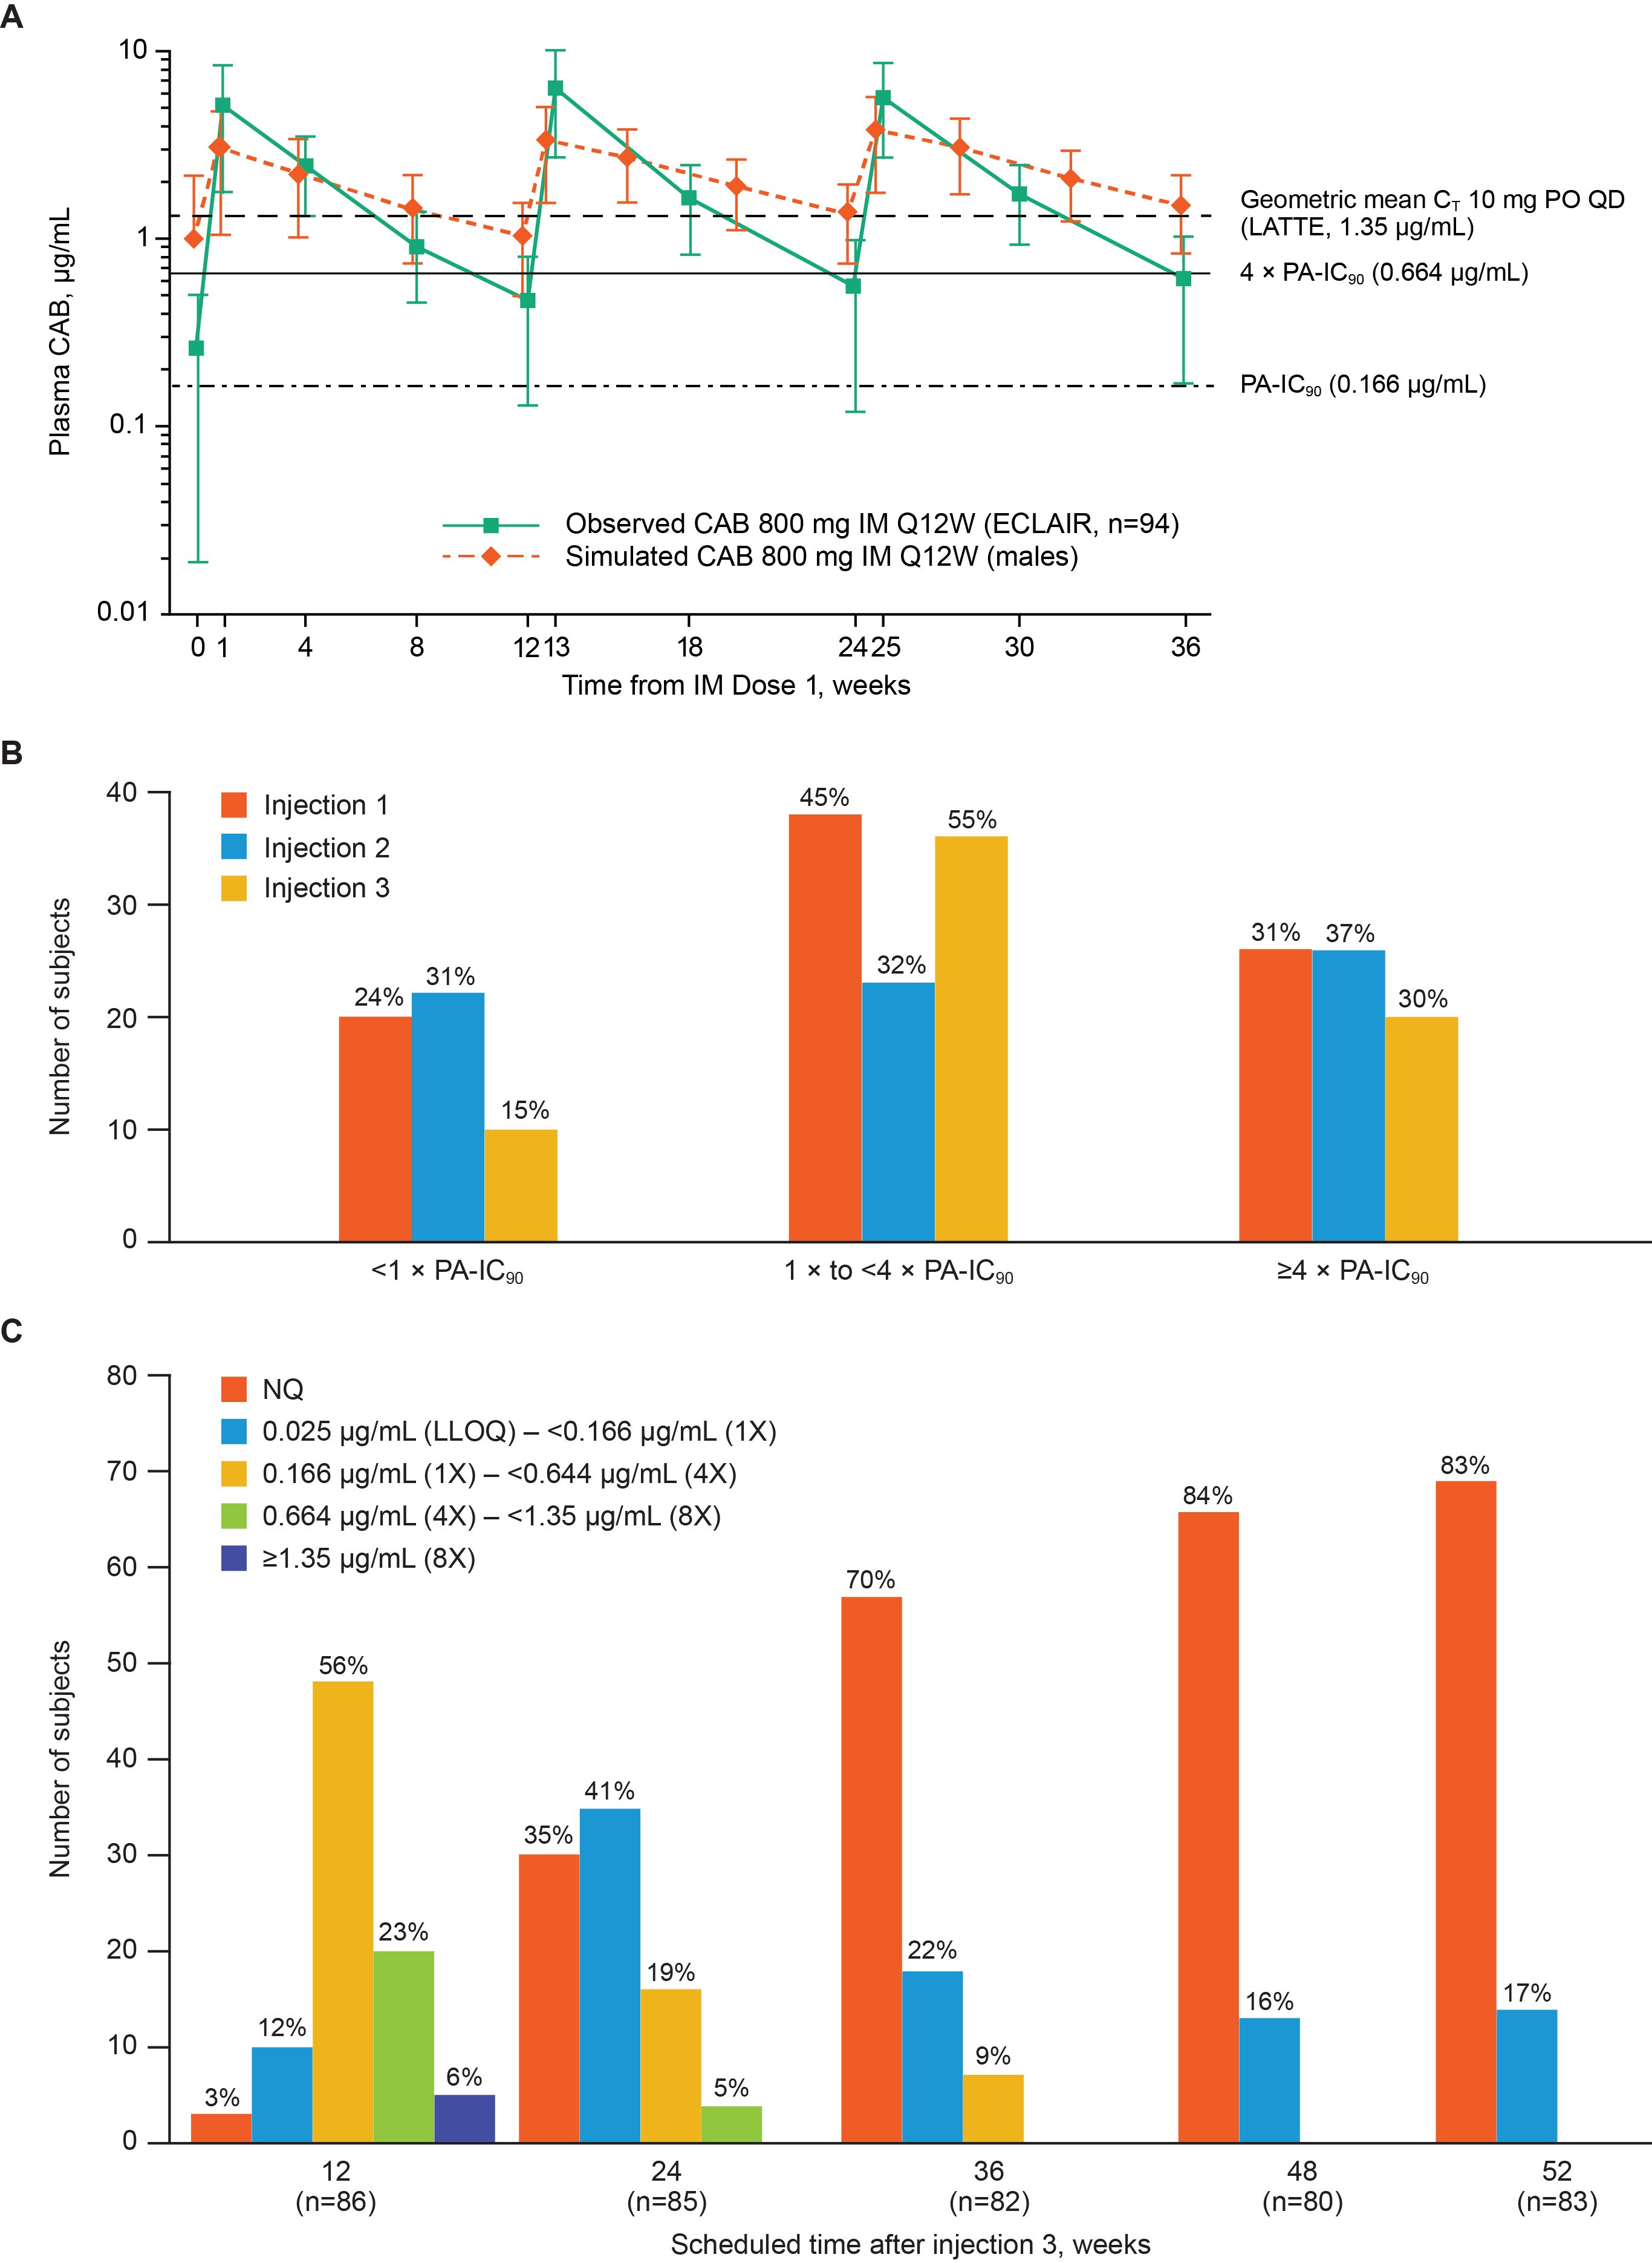
ÉCLAIR CAB Concentration Ranges by Visit
14 subjects had detectable CAB 52 weeks after injection 3
Markowitz, Lancet HIV 2017
Notes:
In the ÉCLAIR study
Most participants had no or one measurable pharmacokinetic concentration in the follow-up phase (figure 3C).
Cabotegravir remained quantifiable (>0·025 μg/mL) but less than the PA-IC90 in 14 (17%) participants 52 weeks after the third injection.
The clinical significance of this remains unclear.
It is important to note that this was in a study of men; data pending from HPTN 077 will be provide more information on the persistence of the tail in women.

Slide 17



Notes:
HPTN 084 is a study that is trying to determine if injectable cabotegravir is more effective than oral Truvada. It is a randomized trial in which everyone receives one active product – either an active Cabotegravir injection with placebo oral tablets or a placebo injection with active oral Truvada tablets.

Slide 18
Primary Objectives
To evaluate the relative efficacy of oral CAB/CAB LA (oral run-in and injections, Steps 1 and 2) vs. daily oral TDF/FTC for HIV prevention (Steps 1 and 2).
To evaluate the relative safety of oral CAB/CAB LA (oral run-in and injections, Steps 1 and 2) vs. daily oral TDF/FTC for HIV prevention (Steps 1 and 2).
Notes:
We hypothesise that cabotegravir will be superior to TDF/FTC for HIV prevention in women.
We will evaluate this in a phase III, open-label trial of cabotegravir compared to oral TDF/FTC in high risk from sub-Saharan Africa. The data from non-human primate studies and studies in HIV infected populations provide sufficient biological plausibility that cabotegravir has the potential to protect women against HIV.
TDF/FTC is currently the only approved as an agent for PrEP. We consider it appropriate therefore to have an TDF/FTC as an active comparator for CAB LA, an experimental PrEP agent. This approach supports the development pathway for a cabotegravir as a new PrEP agent

Slide 19
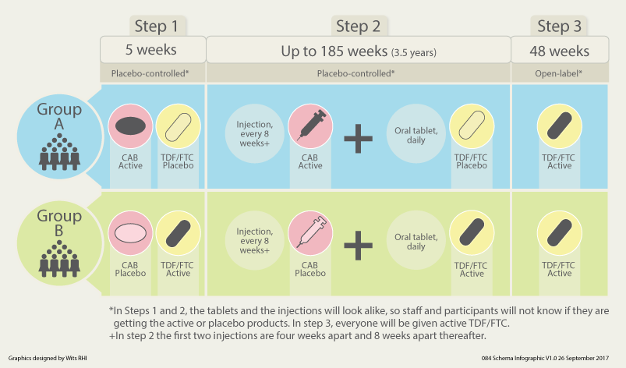
Primary outcome: HIV incidence
Study duration: enrolment 24 months, follow-up 4.5 years

Slide 20


Study Population
20 research sites in 7 countries in sub-Saharan Africa
3,200 women who have sex with men
Expected incidence >3/100 person years
3 Sites in Uganda
1 Site in Kenya
1 Site in Botswana
2 Sites in Malawi
7 Sites in South Africa
5 Sites in Zimbabwe
1 Site in Swaziland

Slide 21
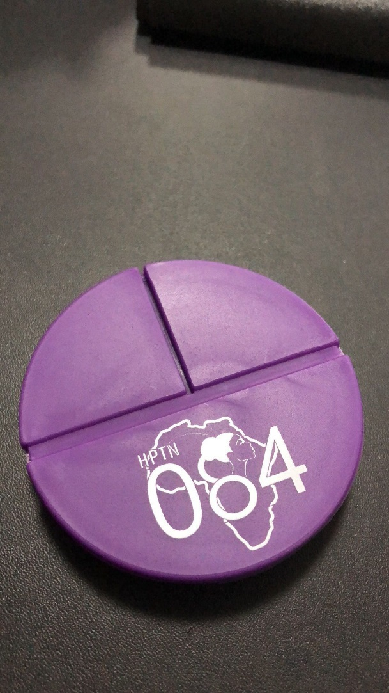
Adherence Support
Support for all beginning at entry and throughout follow-up
Based on current approaches to supporting oral PrEP use in country programs
Assessment of adherence (self report, pill counts)
Notes:
Adherence support will be offered to everyone who joins the study and at each study visit. Assessment of adherence to study product will be measured by self report and pill count. There will be enhanced support provided to individuals who have trouble taking their pills.
Blood samples will be collected for monitoring.
Because this is a blinded trial this information cannot be provided to participants or staff.
This information will be provided to the DSMB who will use this information to help them interpret the progress on the study.

Slide 22

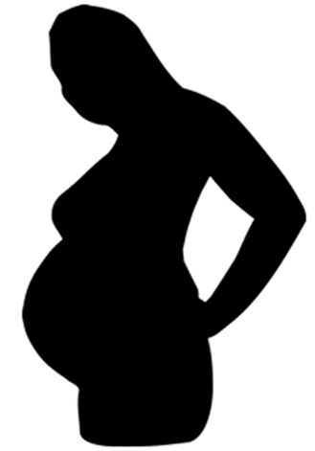
Pregnancy and Cabotegravir
No evidence of embryo-fetal development toxicity or early gestational toxicity has been identified in non-clinical studies
Rat pre- and post-natal data suggests that late pregnancy is period of highest sensitivity
  Highest doses (1000 mg/kg/day) resulted in increased offspring mortality (~12% affected)
  Of the surviving offspring, exposure to CAB during pregnancy or via the milk had no effects
  CAB therefore appears to delay labour and parturition process in rats
  Clinical significance in humans not known
Risk to the fetus is minimized in the trial by the requirements for use of long acting contraception and requirement for pregnancy testing prior to every injection.
Notes:
No treatment-related findings in the 0.5 or 5mg/kg groups

Slide 23
HPTN 084: Maximising safety during pregnancy
Stop Injections at first positive test
Move to “Step 3” and receive oral TDF/FTC
Confirm pregnancy 4 weeks later
Unblind
Refer for early ultrasound for fetal anomalies
Evaluation every 12 weeks
Obstetric monitoring throughout pregnancy and at time of delivery
Evaluate outcomes at delivery and 12 months
Choice to return to step 2 after breastfeeding cessation with use of open-label assigned product
Planned sub-studies of breastmilk and infant PK
Notes:
Risk minimised by pregnancy testing at each visit and requirement for effective contraceptive use

Slide 24
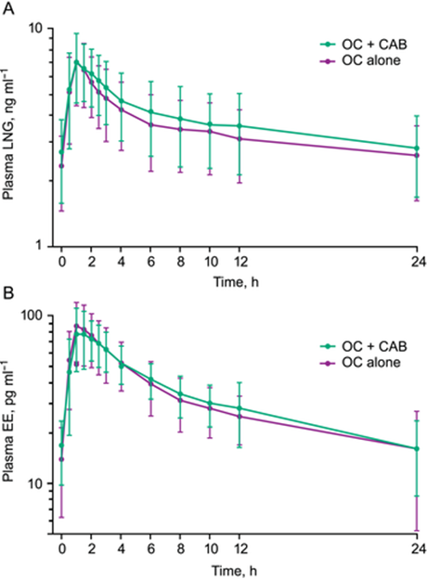
Contraception and Cabotegravir
CAB unlikely to cause or be subject to drug interactions with contraception
One study in healthy female volunteers (n=20) showed no significant PK/PD interactions between oral CAB and combined oral contraceptives (LNG/EE)
No interactions with progestin-only contraceptives are anticipated
Additional evaluations planned in HPTN 084
Spreen, Br J Clin Pharm 2017
Notes:
The GLS mean ratios and 90% CIs for the differences in steady‐state AUC_{0–τ}, C_{max}, and C_{τ} between test (LNG/EO + CAB) and reference (LNG/EO alone) treatments were each within the limits of 0.80–1.25, confirming a lack of pharmacokinetically significant interaction between CAB and LNG or EO
Although the metabolic pathways for such products are complex and vary somewhat from EO and LNG, the current results, in conjunction with CAB being neither a significant inhibitor nor inducer of CYP or UGT isoenzymes at clinically relevant concentrations, support CAB use with caution with other combination or progestin‐only oral or injectable contraceptives.
In vitro and clinical data suggest that cabotegravir (CAB) is unlikely to cause or be subject to clinically significant drug interactions with the components of hormonal contraceptives. Cabotegravir is primarily
metabolized by uridine diphosphate glucuronosyltransferase
(UGT) 1A1 with a minor contribution by UGT 1A9 [6]. At
clinically relevant concentrations, CAB does not inhibit or
induce the major cytochrome P450 (CYP) or UGT enzymes
in vitro
and had no signi
fi
cant effect on the pharmacokinetics
(PK) of midazolam, a sensitive CYP3A4 probe substrate
However, before this present study, it was unknown if
CAB would impact the pharmacokinetic (PK) pro
fi
le of levonorgestrel/ethinyl oestradiol (LNG/EO) in healthy female
volunteers.
WHAT THIS STUDY ADDS
•
Repeat doses of oral CAB had no signi
fi
cant effect on the PK of LNG/EO, and steady-state CAB PK parameters were similar
to previous estimates.
•
This supports coadministration of CAB with LNG/EO
–
containing oral contraceptives.
•
Metabolic and excretory pathways of oral and long-acting inj
ectable CAB are comparable, su
pporting extrapolation of
these results to the long-acting formulation of CAB

Slide 25
Conclusions
Injectable cabotegravir is a promising new product for PrEP
Injectable PrEP appears to be acceptable to many women and may be able to address some of the challenges observed with daily oral PrEP
Additional measures are required in trials of long acting products to maximise safety esp. in women of reproductive potential
These trials remain a priority for expanding the range of HIV prevention options available to women

Slide 26
Jennifer Farrior, Nirupama Sista, Laura Smith
Mina Hosseinpour and HPTN 084 protocol team
Site teams in South Africa, Zimbabwe, Botswana, Malawi, Uganda, Kenya and Swaziland
Participants, CAB and community members
The HIV Prevention Trials Network is funded by the National Institute of Allergy and Infectious Diseases (UM1AI068619, UM1AI068613, UM1AI1068617), with co-funding from the National Institute of Mental Health, and the National Institute on Drug Abuse, all components of the U.S. National Institutes of Health.
Notes:
Leadership and Operations Center (LOC):
Grant #: UM1AI068619
Laboratory (LC):
Grant #: UM1AI 068613
Statistical and Data Management Center (SDMC):
Grant #: UM1AI 068617
Please remove any award number not applicable to presented research

Slide 27
BACKUP SLIDES

Slide 28
CAB LA plasma concentrations >1 X PAIC₉₀ correlate with protection in female macaque model
Radzio, Science Trans Med 2015
Notes:
Efficacy was related to high and sustained plasma drug concentrations that remained above the PAIC 90 during the dosing cycles.
A third study in Chinese rhesus macaques not treated with DMPA and challenged weekly for up to 20 weeks suggested protection was consistent with drug levels 4 X PAIC (98% of animals protected).
These data support a relationship between plasma drug concentration and in vivo efficacy in macaques and provide a dosing range to target for protection in humans

Slide 29
Genital tract tissue concentrations after CAB LA 400 mg IM SINGLE dose in humans
Across visits, median cervical and vaginal tissue:plasma ratios ranged from 0.16 to 0.28.
Median rectal tissue:plasma ratios were ≤ 0.08.
Median cervical and vaginal tissue concentrations were approximately equivalent to the in vitro PA-IC₉₀ (0.166μg/mL)
 | 400mg IM unsplit (Cohort 8) | 400mg IM split (2x 200mg IM, Cohort 9)
Cervical² | 0.20 (0.0 - 0.40) | 0.16 (0.0 - 0.4)
Vaginal³ | 0.28 (0.0 - 0.7) | 0.19 (0.0 - 0.7)
Rectal³ | 0.00 (0.0 - 0.1) | 0.08 (0.0 - 0.2)
¹ median (range) ²n=8 unsplit; n=7 split ³n=24
Spreen, JAIDS 2014
Notes:
While the clinical significance of tissue concentrations for systemically administered antiretrovirals is currently unknown; it is important to understand the relationship between plasma and tissue concentrations
In this study evaluated plasma and tissue pharmacokinetics after single-dose administration of 744 LA administered by intramuscular
(IM)
The 800mg dose achieved mean concentrations above the PAIC90.
In subjects in whom rectal and cervicovaginal biopsies were collected either at weeks 2 and 8 or 4 and 12 after a single dose we see that tissue concentrations range from 8 to 28% of plasma concentrations.
This is not unexpected given the the high protein binding of cabotegravir
Importantly for cervical tissue, these concentrations were were approximately equivalent to 1 X PAIC suggesting that it is possible to achieve these the target exposure range in genital tissues with current proposed doses.

